Slide 1
Macroeconomics – Measuring the Cost of Living
Consumer Price Index (TOPIC 2/ Chapter 24)
Dr. Faria Sultana
Assistant Professor
Department of Economics

Slide 2
THE CONSUMER PRICE INDEX
The consumer price index (CPI) is a measure of the overall cost of the goods and services bought by a typical consumer.
The Bureau of Labor Statistics reports the CPI each month.
It is used to monitor changes in the cost of living over time.
When the CPI rises, the typical family has to spend more dollars to maintain the same standard of living.

Slide 3
Measuring the cost of living: The consumer price index
Consumer Price Index (CPI)
CPI is the price of a basket of goods and services relative to the price of the same basket in some base year.
Example: Suppose a typical consumer buys 5-apples & 2-oranges every month. Thus, basket consists of 5-apples & 2-oranges, the CPI is
CPI=(5*current price of apples)+(2* current price of oranges)/ (5*2002 price of apples)+(2*2002 price of oranges)
Here 2002 is the base year

Slide 4
How the Consumer Price Index Is Calculated
Fix the Basket: Determine what prices are most important to the typical consumer.
  The Bangladesh Bureau of statistics(BBS) identifies a market basket of goods and services the typical consumer buys.
  The BBS conducts monthly consumer surveys to set the weights for the prices of those goods and services.
  Find the Prices: Find the prices of each of the goods and services in the basket for each point in time.

Slide 5
How the Consumer Price Index Is Calculated
Compute the Basket’s Cost: Use the data on prices to calculate the cost of the basket of goods and services at different times.
Choose a Base Year and Compute the Index:
  Designate one year as the base year, making it the benchmark against which other years are compared.
  Compute the index by dividing the price of the basket in one year by the price in the base year and multiplying by 100.

Slide 6



How the Consumer Price Index Is Calculated
Compute the inflation rate: The inflation rate is the percentage change in the price index from the preceding period.
The Inflation Rate
  The inflation rate is calculated as follows:

Slide 7

FYI: What’s in the CPI’s Basket?
16%
Food and
beverages
17%
41%
Transportation
Housing
Education and
6%
communication
6%
6%
4%
4%
Medical care
Other goods
Recreation
Apparel
and services
Copyright©2004 South-Western

Slide 8



CPI Versus GDP Deflator
GDP Deflator: It is defined as the ratio of nominal GDP to real GDP:
The GDP deflator reflects what’s happening to the overall level of prices in the economy

Slide 9



CPI Vs GDP deflator
GDP deflator & CPI give some what different information about what’s happening to the overall level of prices in the economy.
Three Key Differences:
GDP deflator measures the prices of all goods and services produced
whereas CPI measures the prices of only the goods and services bought by consumers
GDP deflator includes only those goods produced domestically. Imported goods are not a part of GDP and do not show up in the GDP deflator.
CPI include imported goods.
3. CPI is computed using a fixed basket of goods whereas GDP deflator allows the basket of goods to change over time as the composition of goods and services changed

Slide 10








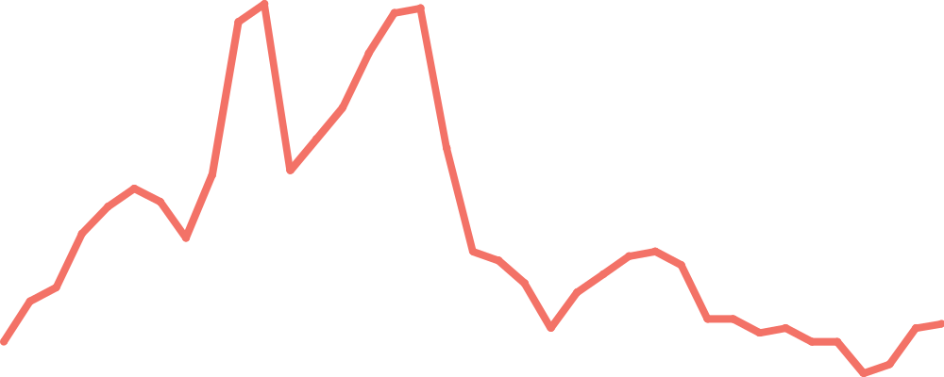
Figure 2 Two Measures of Inflation
Percent
per Year
15
CPI
10
5
GDP deflator
0
1965
1970
1975
1980
1985
1990
1995
2000
Copyright©2004 South-Western

Slide 11
Basic concepts on index number
Definition: An index number is a statistical devices designed to measure the relative changes in the level of a phenomenon (variable) with respect to time, space, location etc.
Selection of the base period:
The base period must be a “normal period”
The base period should not be too distant from the given period

Slide 12


Problems in Measuring the Cost of Living
Inflation: The increase in the overall level of prices. It is one of the primary concern of economists and the policymakers.
Consumer price index is a closely watched measure of inflation.
CPI tends to overstate inflation
-- substitution bias
-- introduction of new goods
--unmeasured changes in quality
Answer for sample qus 2 (b)
From slide 12 to 16.

Slide 13

Problems in Measuring the Cost of Living
Substitution Bias
  The basket does not change to reflect consumer reaction to changes in relative prices.
    Consumers substitute toward goods that have become relatively less expensive.
    The index overstates the increase in cost of living by not considering consumer substitution.

Slide 14

Problems in Measuring the Cost of Living
Introduction of New Goods
  The basket does not reflect the change in purchasing power brought on by the introduction of new products.
    New products result in greater variety, which in turn makes each dollar more valuable.
    Consumers need fewer dollars to maintain any given standard of living.

Slide 15

Problems in Measuring the Cost of Living
Unmeasured Quality Changes
  If the quality of a good rises from one year to the next, the value of a dollar rises, even if the price of the good stays the same.
  If the quality of a good falls from one year to the next, the value of a dollar falls, even if the price of the good stays the same.
  The BLS tries to adjust the price for constant quality, but such differences are hard to measure.

Slide 16

Problems in Measuring the Cost of Living
The substitution bias, introduction of new goods, and unmeasured quality changes cause the CPI to overstate the true cost of living.
  The issue is important because many government programs use the CPI to adjust for changes in the overall level of prices.
  The CPI overstates inflation by about 1 percentage point per year.

Slide 17
Nominal & Real Interest rate
Real Interest rate = Nominal interest rate – Inflation rate
The nominal interest rate is the interest rate usually reported and not corrected for inflation.
  It is the interest rate that a bank pays.
The real interest rate is the nominal interest rate that is corrected for the effects of inflation.

Slide 18
INFLATION
Inflation refers to a situation in which the economy’s overall price level is rising.
The inflation rate is the percentage change in the price level from the previous period.
  Not all prices rise at the same rate during inflation.
  Not everyone suffers equally from inflation.
  Although inflation makes some people worse off, it makes some people better off
Hyperinflation is an extraordinarily high rate of inflation such as Germany experienced in the 1920s.
Hyperinflation is inflation that exceeds 50% per month

Slide 19
Types of Inflation
Demand-Pull Inflation
  Demand-pull inflation results from excessive pressure on the demand side of the economy.
  “Too much money chases too few goods” enabling producers to raise prices.
Cost-Push Inflation
  The pressure on price could also originate on the supply side.
  Higher production costs put upward pressure on product prices

Slide 20
Effects of Inflations [on..]
 | Consumers | Producers | Economy
Zero inflation | Not affected at all | No incentive to produce more, Same production | Stagnant for almost same level of production
Mild Inflation | Affected but not much, Demand may be same | Have incentive to produce more, Higher production | Economy expands as production increase
High Inflation | Affected much, Demand may be lower in many products | Producers of inelastic products affected, Production lower for lower demand | Economy squeezes as production falls

